Slide 2
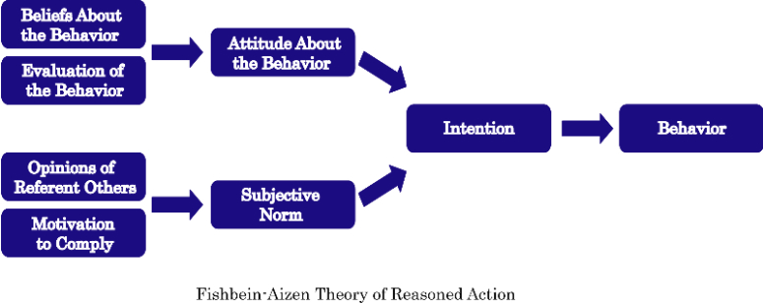
The Theory of Reasoned Action

Slide 3
Organ Donation Campaigns

Slide 4
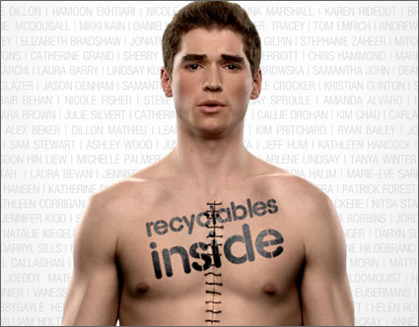

Slide 5


Slide 6
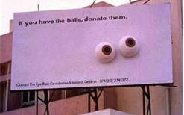

Slide 7
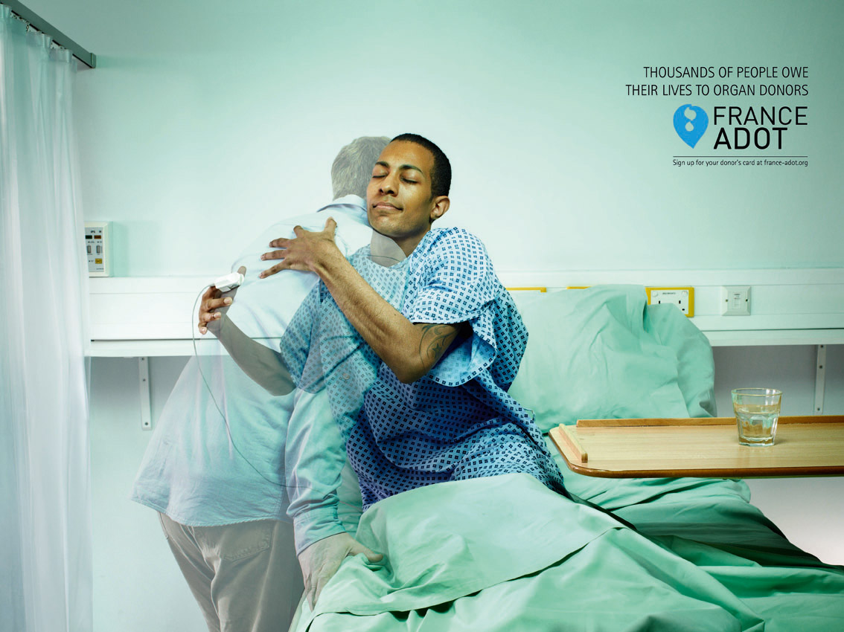

Slide 8
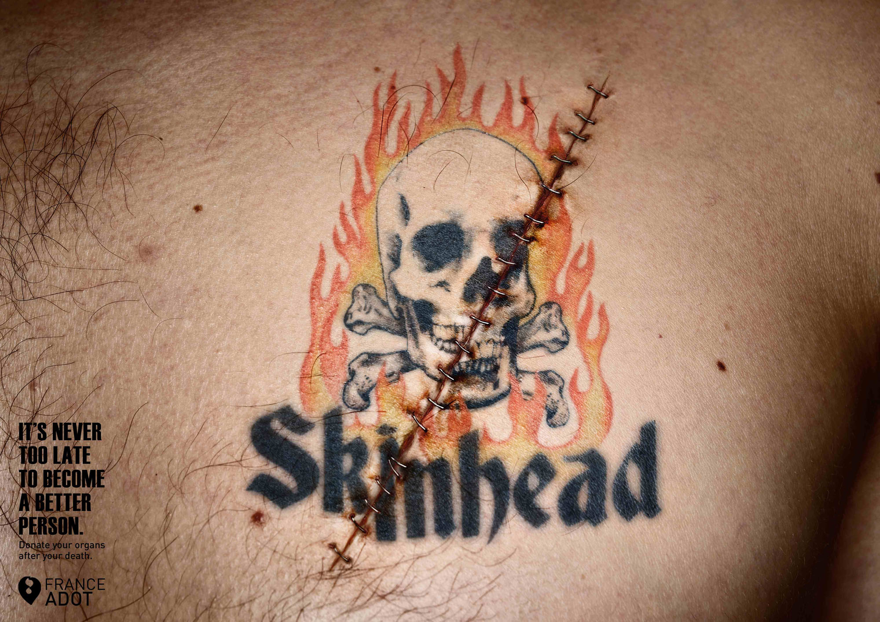

Slide 9
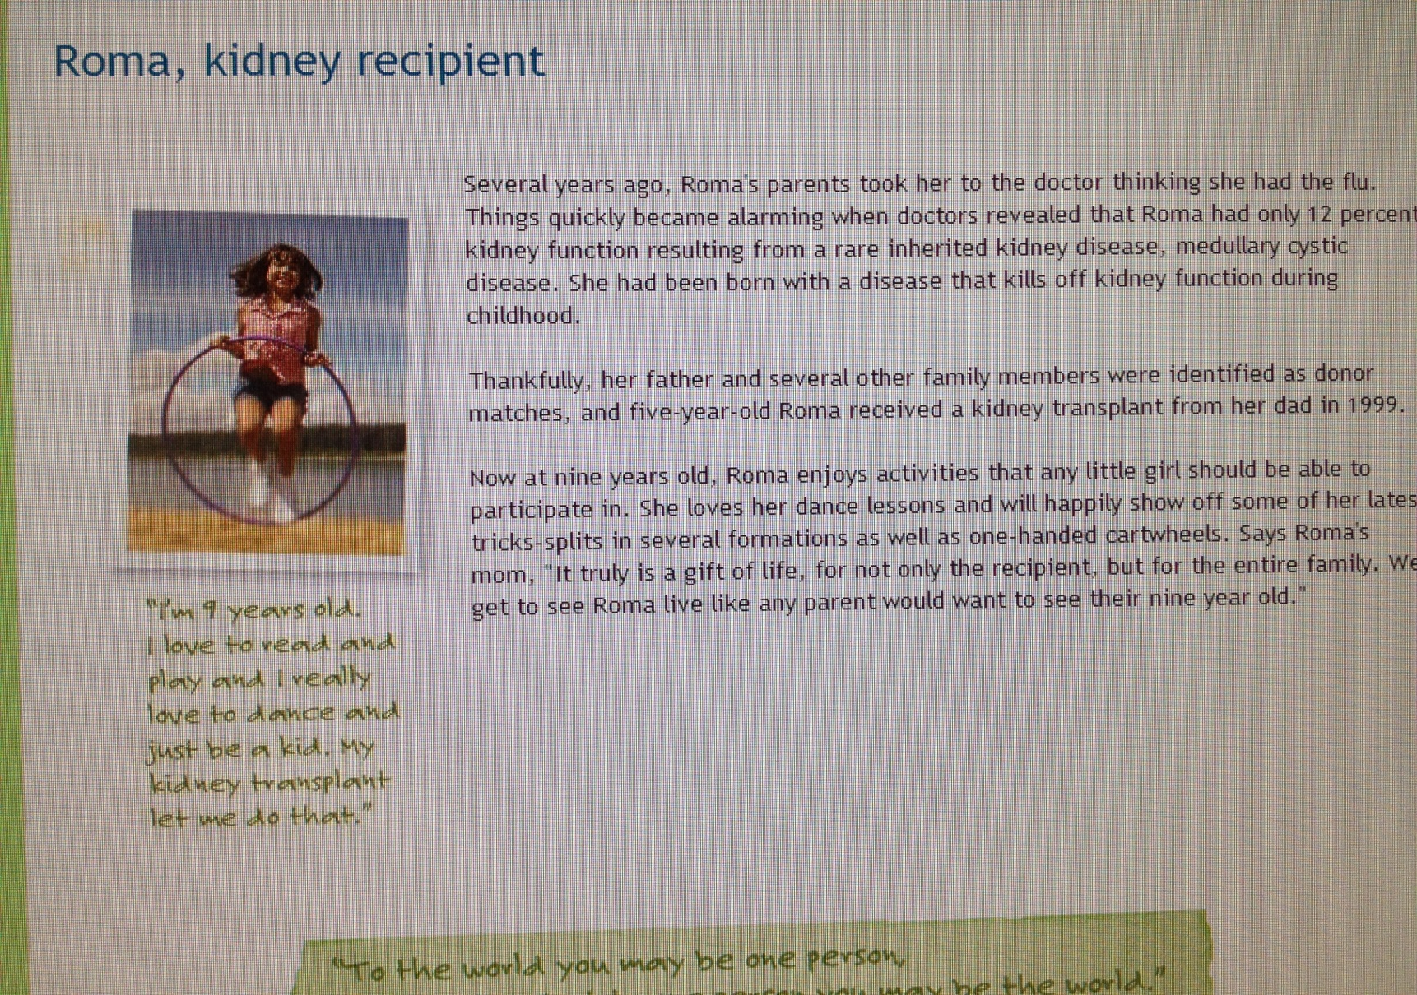

Slide 10
Campaigns Tried to Address Myths, but That Didn’t Really Work

Slide 11
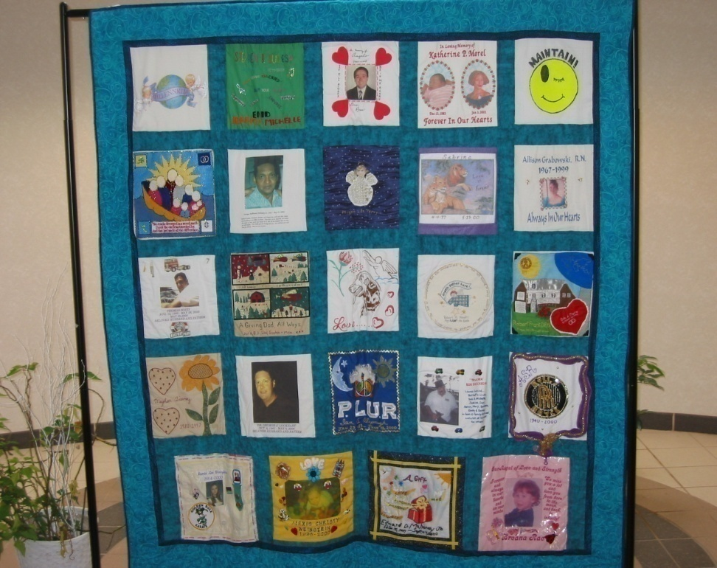
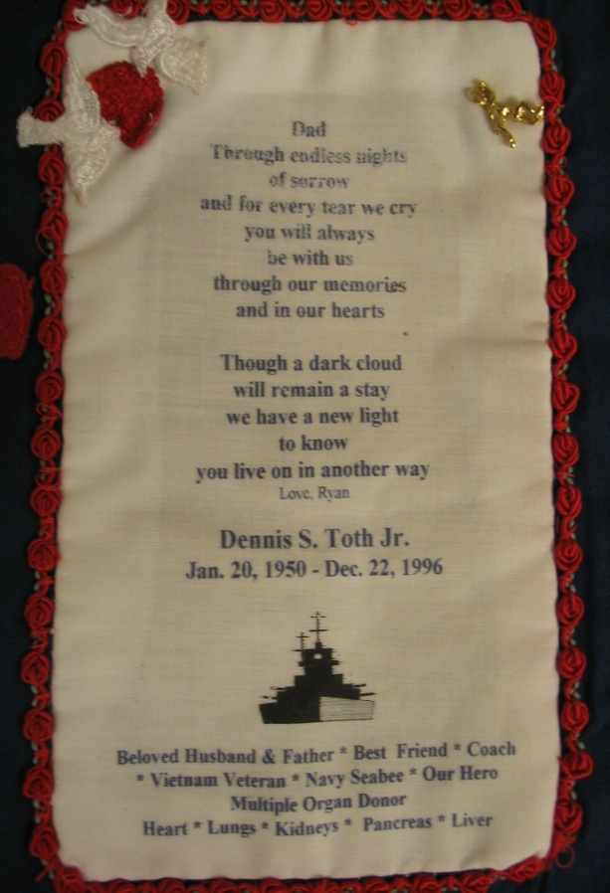

Slide 15
Research Driven Examples

